Slide 1
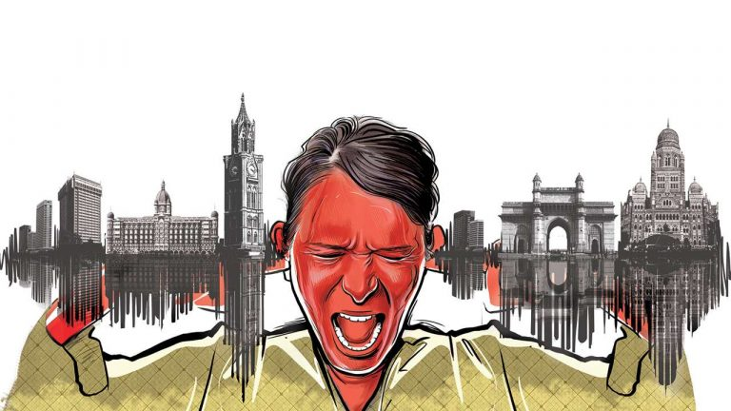
CASE STUDY FOR NOISE POLLUTION

Slide 2
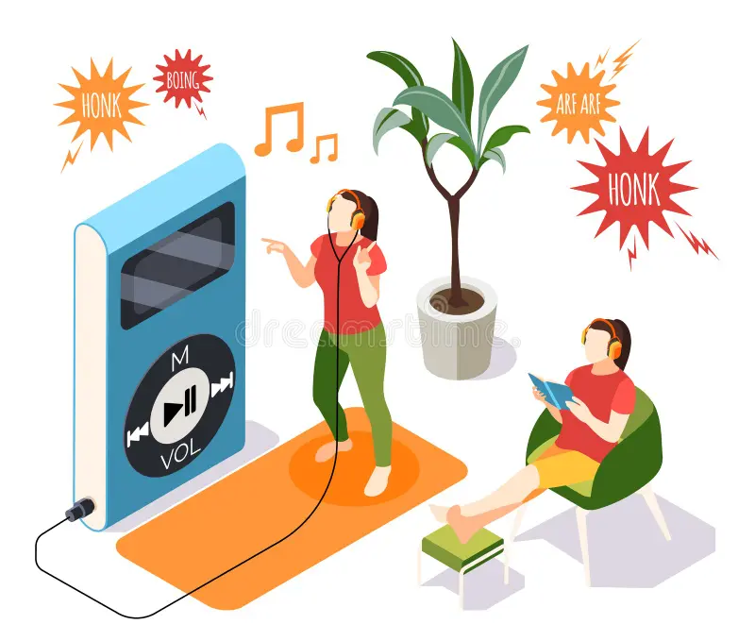
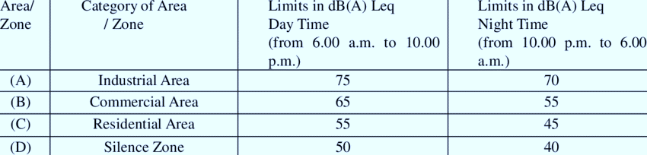
Noise in metropolitan cities can be divided into two parts
Industrial Noise
Community Noise
.

Slide 3
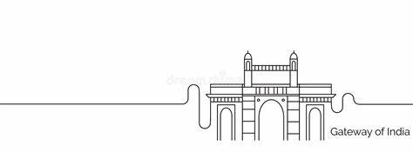
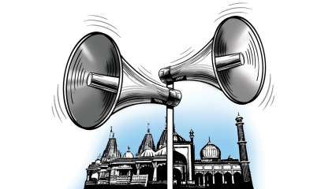
MUMBAI :
average of 75dB during the day and 65dB at night , irrespective of silence or residential zones.
Ganeshotsav, Mumbai’s noisiest festival, the highest recorded noise level was 123.2 decibels (dB).
Chhatrapati Shivaji Terminus (CST) (95.3dB) is usually the noisiest location across Mumbai .
average noise level from horns in Mumbai is 110 decibels (dB) and construction sites is 129dB .
, the police booked 3,176 offenders for reckless honking and 507 persons for using illegal horns.
During Covid-19,the loudspeaker noises from religious places increased.

Slide 4
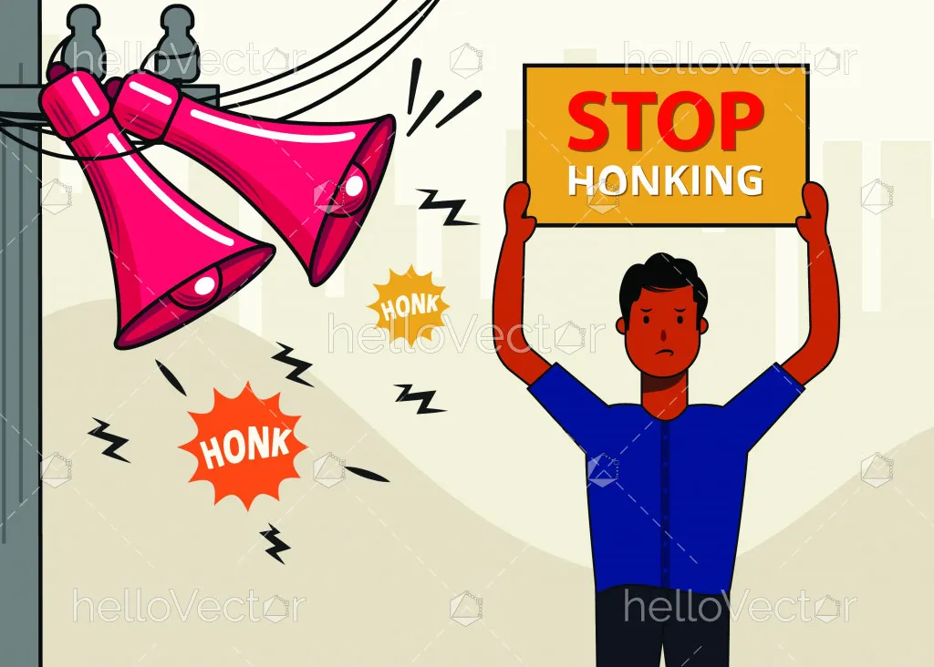
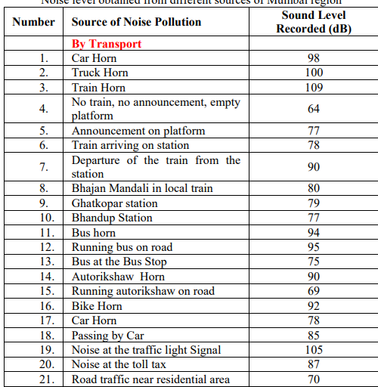

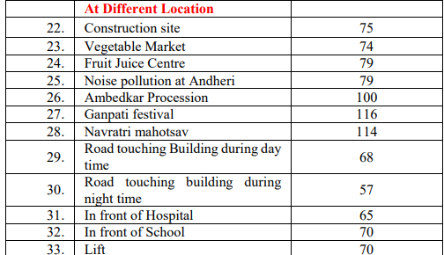

Slide 5
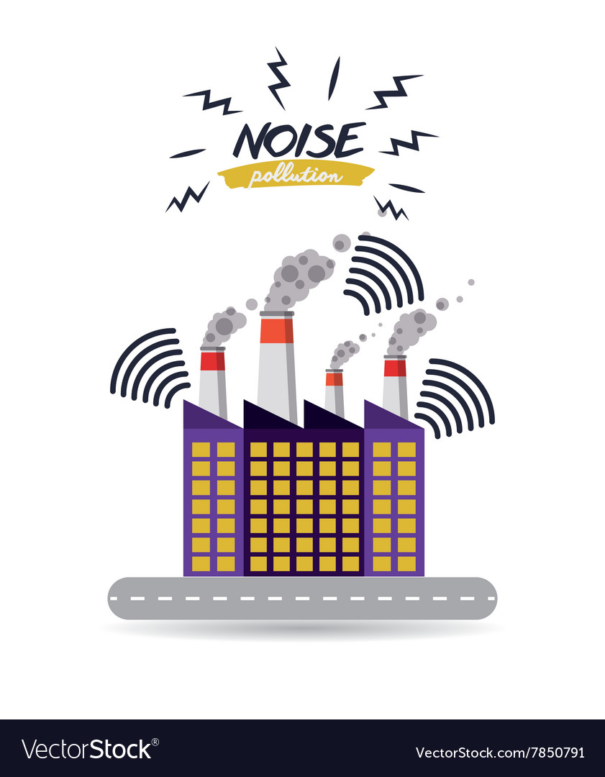
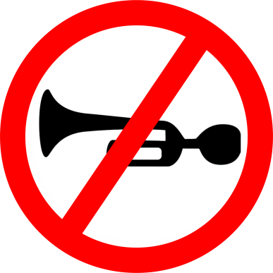
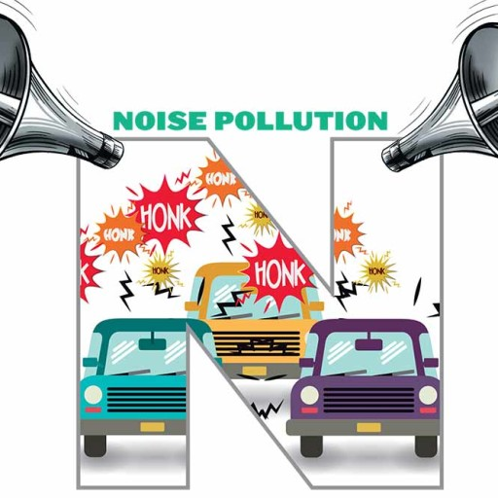
MAJOR REASONS FOR NOISE POLLUTION IN MUMBAI
Traffic Congestion
Construction Activity
Commercial Areas
Religious and Cultural Events
Public Transportation
Population Density

Slide 6



THE AAWAZ FOUNDATION
Over the past 20 years, recorded noise levels in Mumbai
regularly.
Three month awareness campaign with TOI.
A partnership with the Government of Maharashtra
against honking alongside the Mumbai Autorickshaw
Union launched at the Gateway of India.
Ganeshotsav samitis agreed to keep in check during the festival .
Recently , free apps for noise measurements made accessible to everyone.

Slide 7
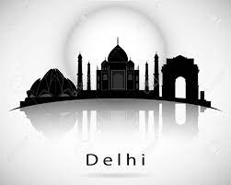

Delhi
Brief Overview of Delhi:
Capital city of India.
Rich history and diverse culture.
Significant economic, political, and social influence.
Population and Density:
One of the most densely populated cities globally (exceeding 20 million).
Major Hub for Various Sectors:
Hub for commerce, trade, and business activities.
Prominent center for education and academic institutions.
Prime tourist destination with numerous historical and cultural attractions.
Central location for government operations and administrative activities.

Slide 8
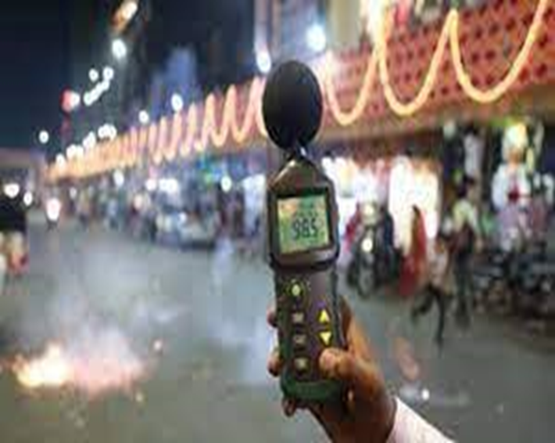
Reasons of Noise Pollution :
Road Traffic:
Dense road network in Delhi.
Traffic noise from cars, buses, and trucks is a major contributor.
Construction Activities:
Rapid urban growth leads to continuous construction.
Noise from construction machinery and equipment is significant.
Aircraft:
Indira Gandhi International Airport is one of the busiest globally.
Noise from aircraft taking off and landing can be disruptive, especially for nearby residents.
Social Events:
Delhi hosts various religious and cultural festivals.
Loud music and fireworks during these events contribute to noise pollution.

Slide 9
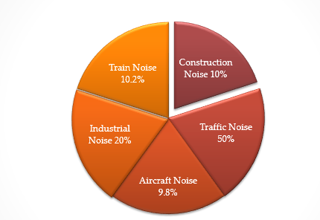
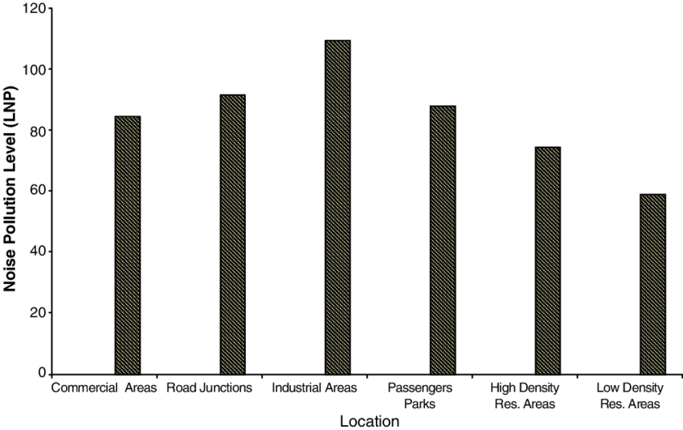
Reasons of Noise Pollution

Slide 10
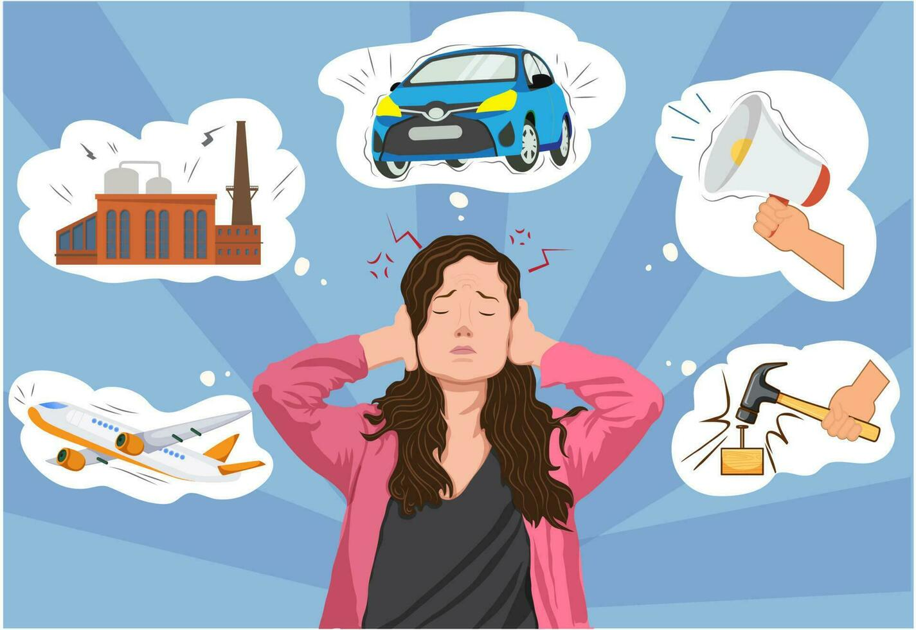
There is a lot of damage that happens in Delhi due to noise pollution :
Hearing Loss
Stress and Anxiety
Sleep Disturbance
Cardiovascular Issues
Impact on Wildlife
Educational Impact
Traffic-Related Issues
Residential Property Values

Slide 11
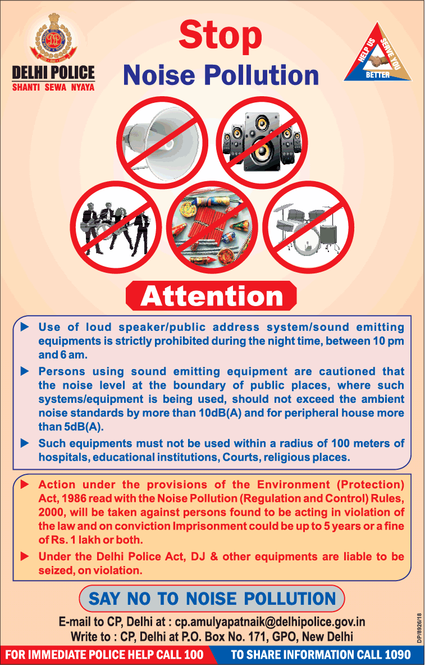
This is Delhi’s first noise pollution action plan.
The Delhi Pollution Control Committee (DPCC) has been fixed. According to the plan, all civic agencies would have to identify ‘noise hotspots’ within their jurisdiction by September 2019. The Noise Pollution (Regulation and Control) Rules, 2000 would be strictly implemented in these areas, along with the ‘silence zones’.
An area of 100 meters around schools, hospitals, courts and government offices has been designated as ‘silence zone’.

Slide 12

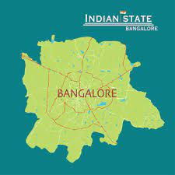
Bangalore: Case study
This case study of Noise pollution of Bangalore is divided into three phases –
Pre-lockdown (before 25th March 2020)
Lockdown (25th March 2020 to 31st May 2020)
Post-lockdown (after 31st May 2020)

Slide 13
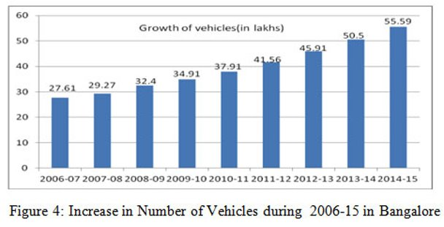
PRE-LOCKDOWN phase
As result of rapid urbanization, high population density, and consequent increase in vehicular traffic and engine noise, noise pollution in Bangalore significantly increased.
It often exceed the limit set by the Indian Central Pollution Control Board.
Furthermore, ongoing construction and infrastructure development generate additional noise pollution.

Slide 14
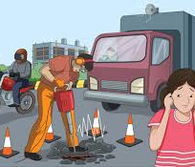
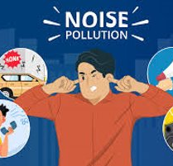
From Pre-Lockdown to Lockdown.
During the lockdown there were the following changes-
Reduction of Traffic Noise
Closure of Industrial Activities
Economic Slowdown
Therefore , there was average 11.5% reduction in noise pollution in the commercial and the industrial areas.

Slide 15
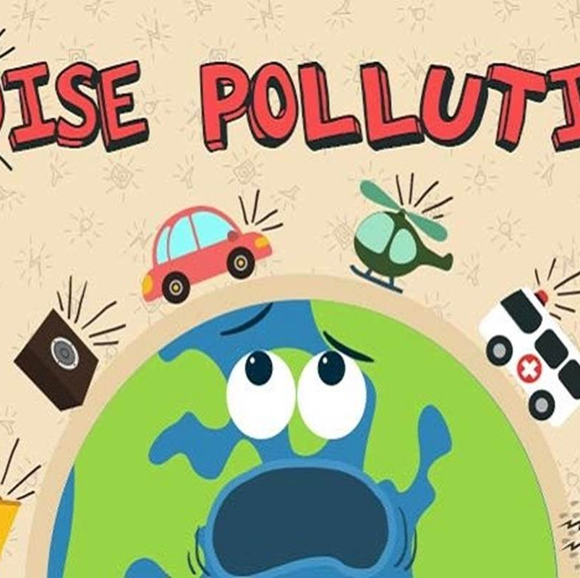
From Lockdown to Post-Lockdown
However, in the post lockdown,
Businesses and industries reopened, along with public transportation.
Increase in traffic.
Restrictions on public gatherings were removed.
Therefore, in the post lockdown, the average noise level was in-creased by 8.41% in the industrial areas.

Slide 16
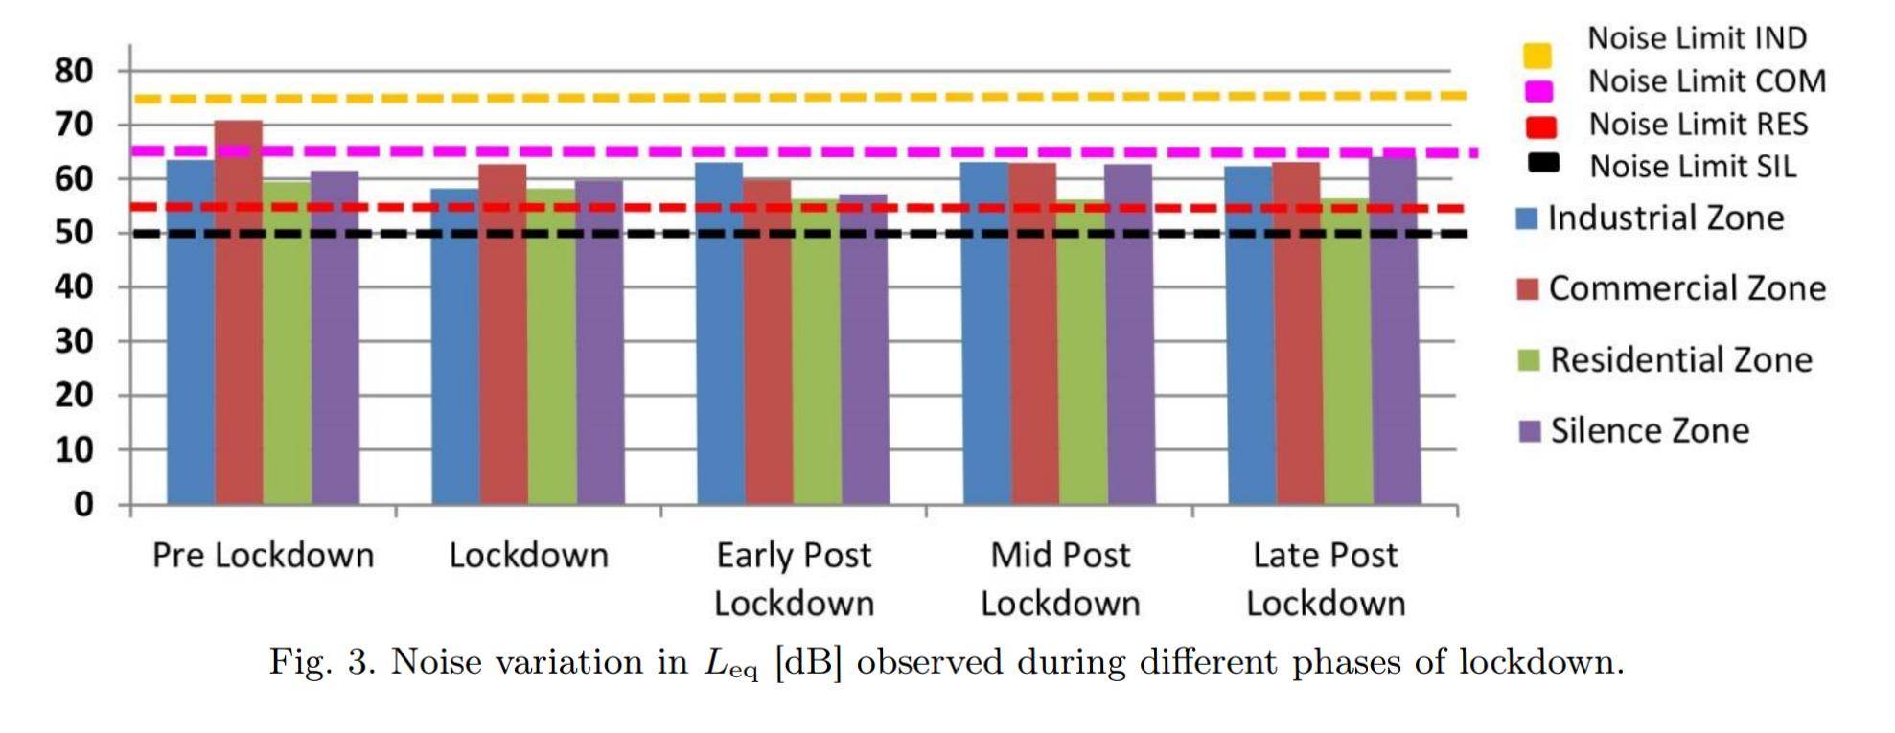
Graph-

Slide 17


STEPS TO REDUCE NOISE POLLUTION
Restricting access for the noisiest vehicles
No-honking policy.
Written permission for the use of loudspeakers between 10 pm and 6 am .
Furthermore, more research may be required to address the long-term effects of noise pollution and improve road safety

Slide 18
Thank you

